Slide 1



Final Presentation
Recognizing Autism in Mice by Analyzing their Squeaks
Students: Alon Schreuer, Itamar Ginsberg
Supervisor: Dr. Dror Lederman
Semester: Spring 2021
Date: 10/1/21
In collaboration with: Prof. Hava Golan (BGU)

Slide 2
Outline
Project Goal
Background
Previously Proposed solutions
Chosen solution
Results
Conclusion, What’s next?

Slide 3
Project Goal
Develop an algorithm to detect ASD (Autism Spectrum Disorder) based on voice signals of mice
Goals:
Extract informative features
Develop a Machine Learning classification model

Slide 4
Background
Autism (ASD)
A neurological developmental disorder
US: 1 in 54 children is diagnosed with ASD (CDC, 2016)
Israel : 1/187 (National Insurance, 2018)
MTHFR deficiency increases the risk of ASD symptoms in both humans and mice
Diagnosed around age 4-5, based on behavioral observation

Slide 5
Background – unmet need
Why is this fascinating, meaningful and important?
Early detection has an immense impact on treatment and care
Severity of the symptoms varies greatly, so diagnosis is challenging and imprecise
No objective diagnostic tool

Slide 6
Literature review
Baltaxe & Simmons (1975) – behavioral classification of autistic symptoms
USV: Ultra-Sonic Vocalization
Used by mice and rodents for communication
Occur @20-100 kHz (above human hearing range)
Can be classified into 10 distinct syllables

Slide 7
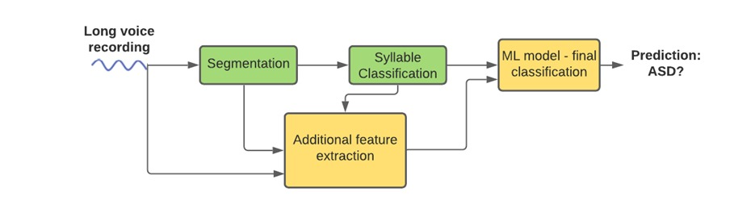
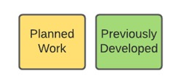
Model

Slide 8
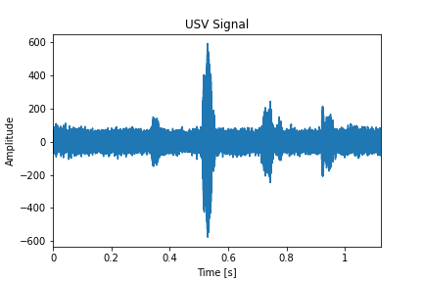
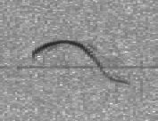
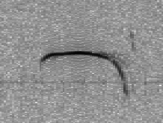
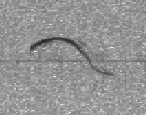
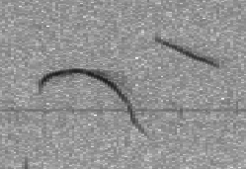
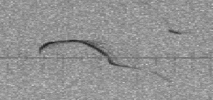
Previous work
Syllable segmentation
chevron
Two-Syllable
Max
Two-Syllable
Min
Two-Syllable
Start
End
8

Slide 9
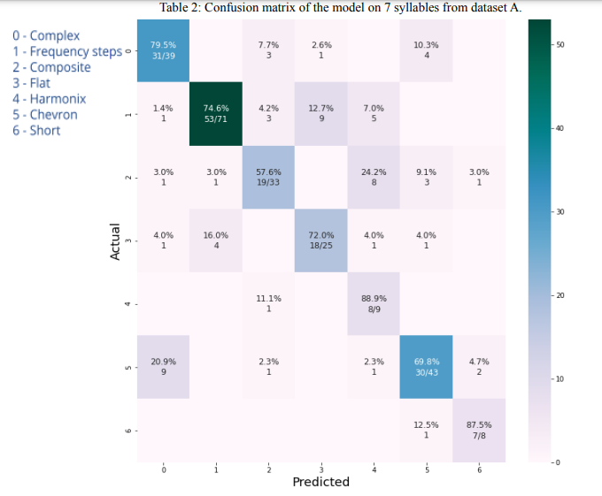
Previous work
Syllable classification
Produced and worked on spectrograms of dataset
Achieved avg. accuracy of 86%
9

Slide 10
Previously Proposed solutions
Deep Learning methods
LSTM
Does not use previous work
End-to-end model, harder to debug
CNN
Works on spectrograms, image processing methods
Problem: dataset not large enough!
XGBoost
Very successful
Simple

Slide 11
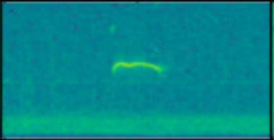
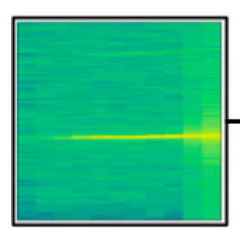
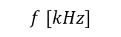

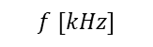

Dataset
$$f [kHz]$$
4,880 single-syllable recordings
66 mice
Include all 10 syllables
Information:
Name
Sex
Mother genotype
Start + end times
Start + end frequencies
Time between syllables
Syllable duration
Syllable class
Our label: pup genotype
$$t [μs]$$
$$f [kHz]$$
$$t [μs]$$

Slide 12
Feature extraction
7 prominent features, represented by 43 numbers
Syllable distribution (10)
Syllable mean start frequency (10)
Syllable mean end frequency (10)
Syllable mean duration (10)
Mother genotype (1)
Sex (1)
Mean time between syllables spoken (1)

Slide 13
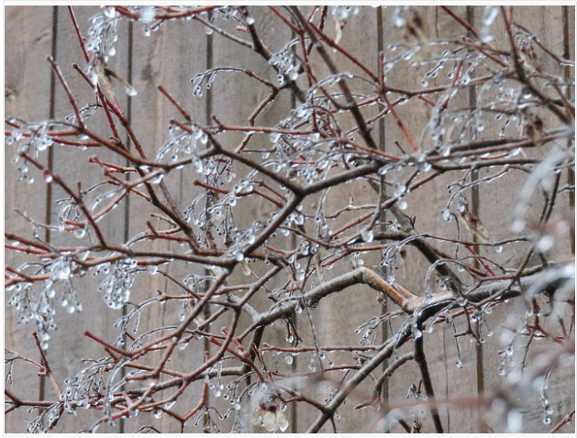
Final Classification Model
XGBoost
Uses consecutive decision trees
Boosting – each tree focuses on previous tree’s error

Slide 14
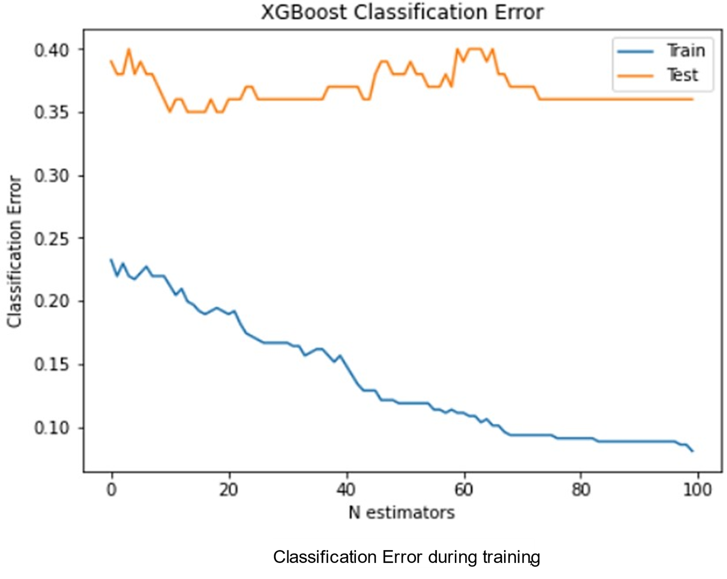
Preliminary Results
64%

Slide 15
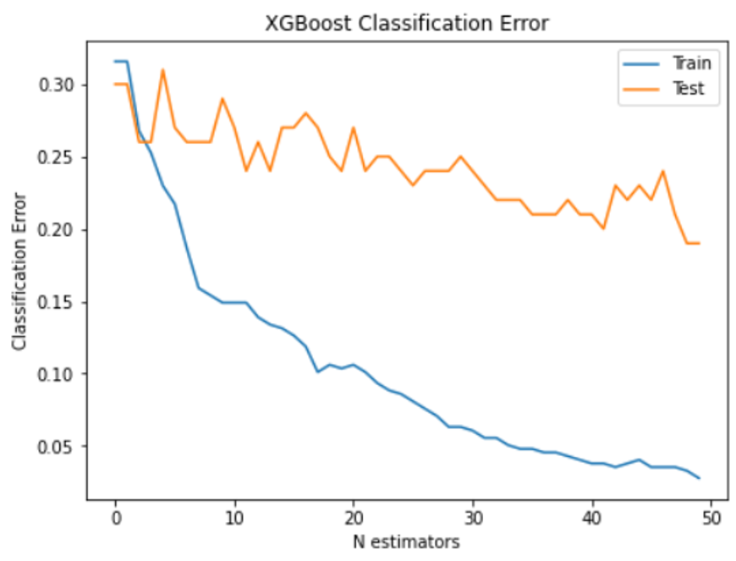
Intermediate results
81%
Mother genotype added
+
Wider dataset
64%

Slide 16
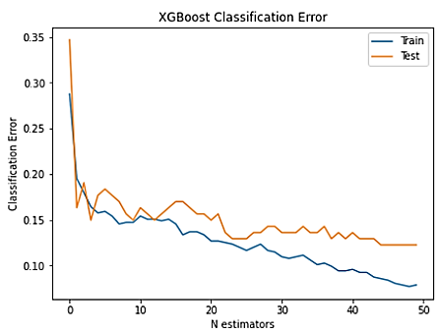
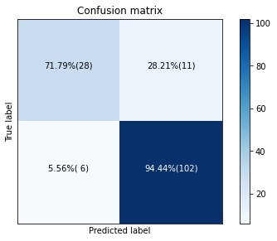
Final Results
88%
Regularization
+
2 additional features
81%
Mother genotype added
+
Wider dataset
64%

Slide 17
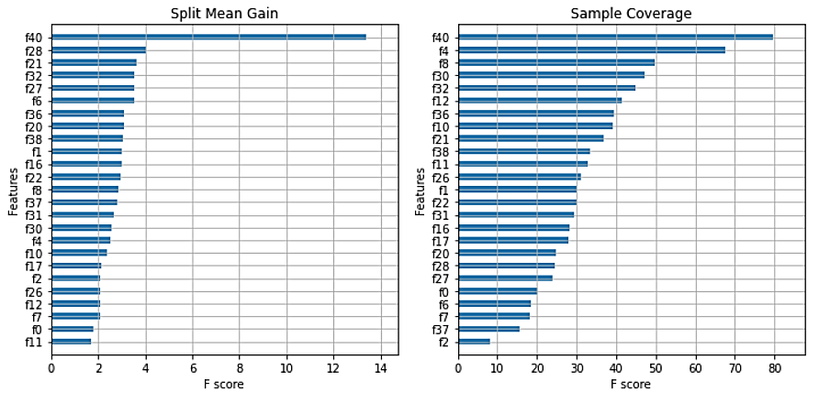
Feature Importance
Feature importance in descending order

Slide 18
Conclusions
The goal – early detection of autism
Using mice and ML
XGBoost
88% accuracy
For the first time: a fully diagnostic tool

Slide 19
Future Work
Focus on most relevant features
using feature selection
Extract additional features
Deep learning methodology

Slide 20
References
[1] A. Masi, M. DeMayo, N. Glozier, and A. Guastella, “An Overview of Autism Spectrum Disorder, Heterogeneity and Treatment Options,” vol. 33, no. 2, pp. 183–193, 2017, doi: 10.1007/s12264-017-0100-y.
[2] A. S. Heinsfeld, A. R. Franco, R. C. Craddock, A. Buchweitz, and F. Meneguzzi, “Identification of autism spectrum disorder using deep learning and the ABIDE dataset,” vol. 17, p. 16, 2018, doi: 10.1016/j.nicl.2017.08.017.
[3] N. Sadigurschi and H. M. Golan, “Maternal and offspring methylenetetrahydrofolate-reductase genotypesinteract in a mouse model to induce autism spectrum disorder-like behavior,” vol. 18, no. 1, p. n/a, 2019, doi:10.1111/gbb.12547.
[4] A. H. O. Fonseca, G. M. Santana, B. O. Gabriela,M., S. Bampi, and M. O. Dietrich, “Analysis of ultrasonic vocalizations from mice using computer vision and machine learning,” vol. 10, 2021, doi: 10.7554/eLife.59161.
[5] H. M. Golan, “USV_MTHFR_CPF_MS”, Frontiers in Neuroscience vol.15, p. 11/22/2021, doi : 769670
[6] Tianqi Chen ,Carlos Guestrin,” XGBoost: A Scalable Tree Boosting System”, Proceedings of the 22nd ACM SIGKDD International Conference on Knowledge Discovery and Data Mining, p. August 2016 doi.org/10.1145/2939672.2939785

Slide 21

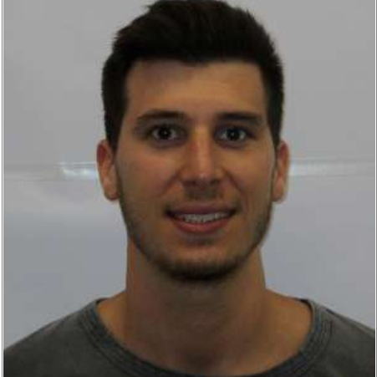
Questions?
Itamar Ginsberg https://www.linkedin.com/in/itamar-ginsberg/
Alon Schreuer https://www.linkedin.com
/in/alon-schreuer-90ba39197/
Project Github repository: https://github.com/etgins/
Mice_ASD_Detection

Slide 22
Results
88%
Regularization
+
2 additional features
81%
Mother genotype added
+
Wider dataset
67%

Slide 23
Assumptions
You cannot assume that your audience
is aware of your project
remembers your specification form or midterm presentation
knows all the relevant theory
You can assume that your audience has a general knowledge of signal processing
E.g., no need to explain what a filter is or what deep learning is
Emphasize aspects that are unique to your project rather than general concepts

Slide 24
Giving Your Talk
Show enthusiasm
If you do not seem excited about your project, why should the audience be?
Make sure that the presentation takes the required amount of time
About 25 minutes for a midterm presentation
About 40 minutes for a final presentation
Practice
Know the material
Prepare for questions

Slide 25
Giving Your Talk - Technicalities
Face the audience, not the screen
Point at the screen, not at your laptop
With a laser pointer or a PowerPoint virtual laser pointer and not with your hand
Make eye contact
Use your voice and body language effectively
Voice: louder/softer, higher/lower, faster/slower, pauses and repeats
Body language: can convey emphasis and excitement

Slide 26
Presenting Information
Don’t include details that you do not intend to describe
Describe everything that is included in the slides
Define unknown terms before using them
Specify the axes and units of graphs

Slide 27
Presenting Information
Prefer visualizations and animations over text
But only use them when they are relevant, not just to show off
No need to reveal the points one-by-one, unless there is a punch line
Use short sentences
Do not use very long sentences like this one, which end after many words, contain many details and are difficult to follow or understand

Slide 28
Formatting
Do not show too many details in a single slide
Use a large font size, even in graphs and diagrams
Make your slides look professional
Use consistent formatting
Look for typos and small issues
Use high-quality images and graphs
Emphasize with colors, font weight and font size
But do not do that too much
Prefer a white or other solid-colored background

